Slide 1
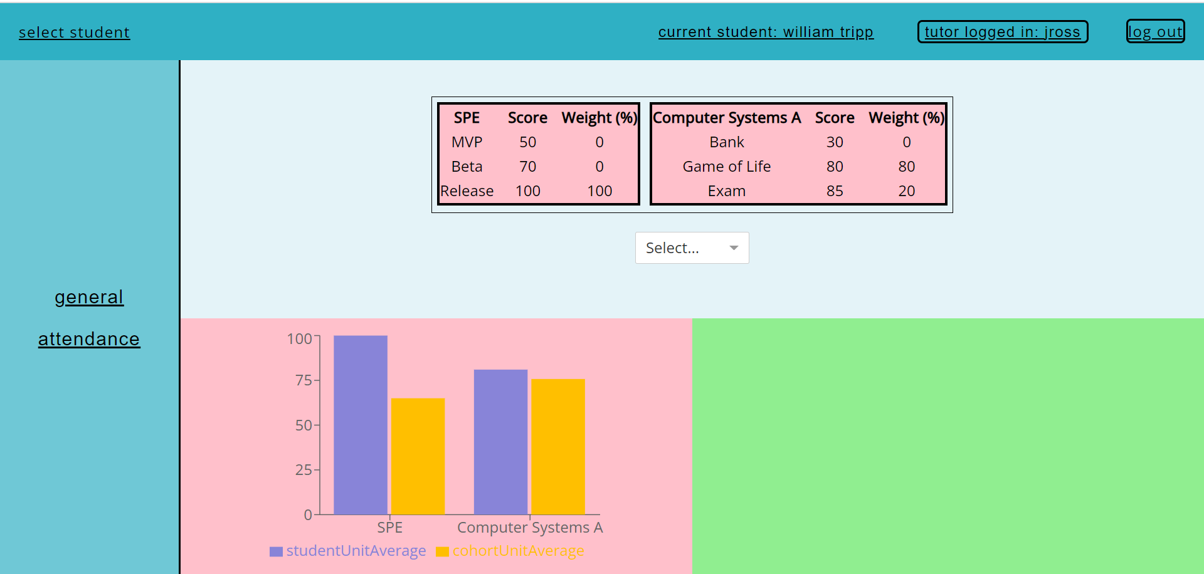
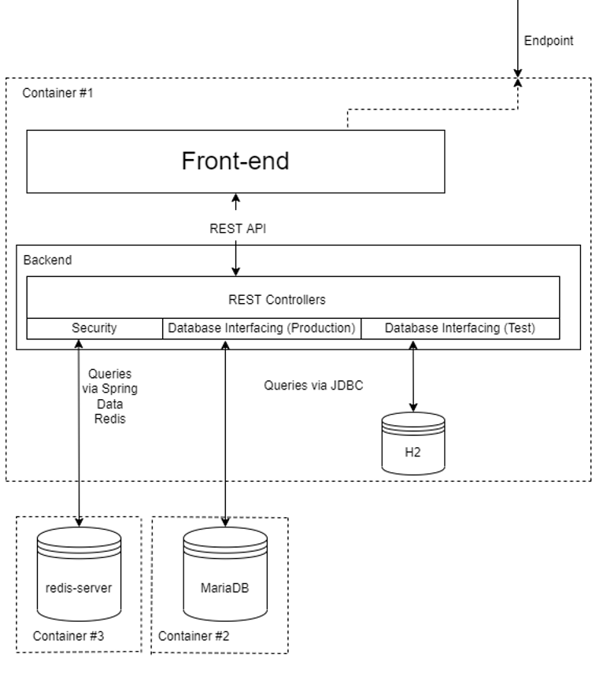
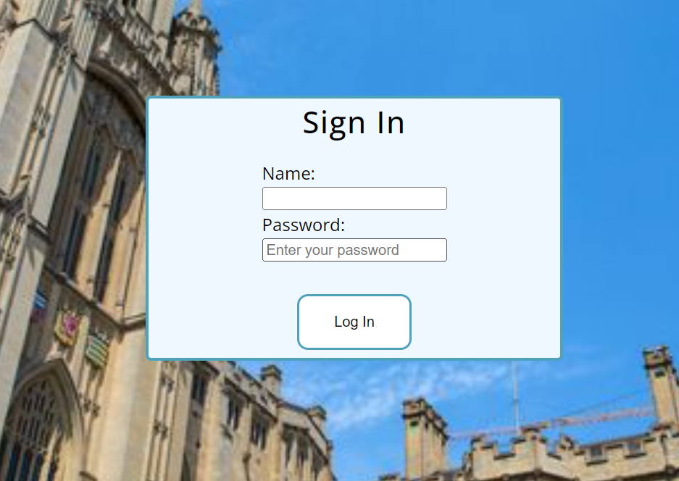
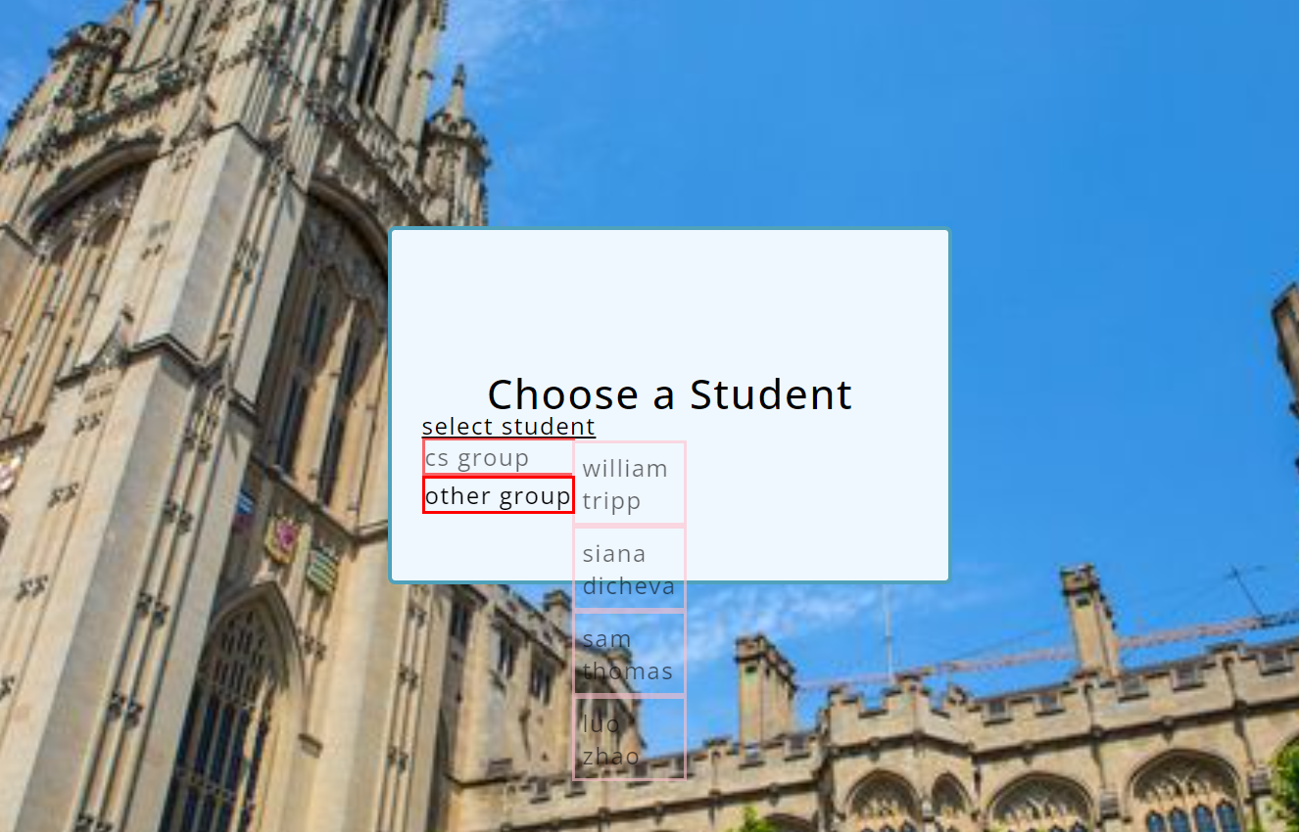
Normal Analytics
Personal Tutor Dashboard Application
Sam Thomas, Siana Dicheva, William Tripp and Luo Zhao for Department of Mechanical Engineering,
University of Bristol
Opportunity & Problem
Solution
We were given the opportunity by Joel Ross, a Senior Lecturer at the Faculty of Engineering at University of Bristol. Joel has would like to give more to support his students, but due to how spread out and time-consuming the information regarding each student is to find, he is not able to give feedback and support in much depth.
This is how our project was created and it consists of a web application for the use of personal tutors within the University in order for them to further support their students by having all relevant student information in a single, easy to navigate service.
The tutor will be able to select a student and a group from a list of their specific students and be welcomed with a dashboard displaying a general overview of the student's academic progress throughout all units – including formative and summative assignments
From here, the tutor will be able to compare a student's result with the average result of the cohort in order to more easily identify areas that may require extra support, as well as the student's average overall grade as this is something that is not currently available to tutors.
There will be a page dedicated to students' attendance, displaying graphs specific to a unit or all of them with different filtering options.
Front-end
Backend
We are using React JS as the main technology behind presentation layer of the project. It is connected to the backend through REST API.
SpringBooth server is the main backend component for the dashboard, which is connected to a database, redis-server for security and the front-end through REST controllers.

